Slide 1


HR ANALYTICS EMPLOYEE RETENTION.
Project Members :
MS. SONIA. R
MR. MOHAMMED WAHAJ HUSSAIN

Slide 2
Table of contents.
01
02
03
Introduction & Problem Statement
Business Objective
KPIs
04
05
Dashboard
Conclusion

Slide 3
Introduction
01
The Collection And Analysis Of HR - related Data, Including Employee Data, Performance Metrics, And Other Relevant Data Points. By Using Advanced Analytical Tools And Techniques, HR Analytics Provides Valuable Insights Into HR Processes And Trends, Enabling Organizations To Make More Informed Decisions About Their Employees And Improve Overall Performance.

Slide 4
Problem Statement :
Average attrition rate for all Departments.
Average hourly rate of Male Research Scientist.
Attrition rate Vs Monthly Income stats.
Average working years for each Department.
Job role Vs Work life balance.
Attrition rate Vs Years Since last promotion

Slide 5
BUSINESS OBJECTIVES
The aim of this project is to analyze employee retention and attrition rates with the organization and provide insights to the HR team for developing effective retention strategies. Through data analysis and visualizations, we will identify factors that contribute to :
Employee turnover and attrition.
Evaluate the effectiveness of existing retention strategies.
To verify the satisfaction level of employee in the organization.
Provide recommendations to improve employee retention.

Slide 6
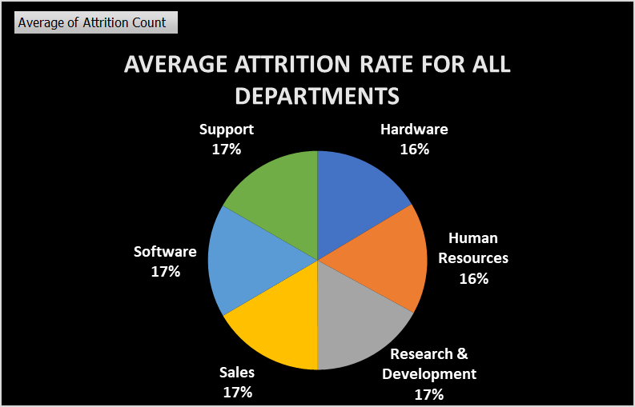
KPI-1:
Average Attrition Rate For All Departments.
This KPI is to find out the Relationship between each Department and its attrition rate and here attrition rate is highest for research & development department whereas lowest is for hardware department.

Slide 7
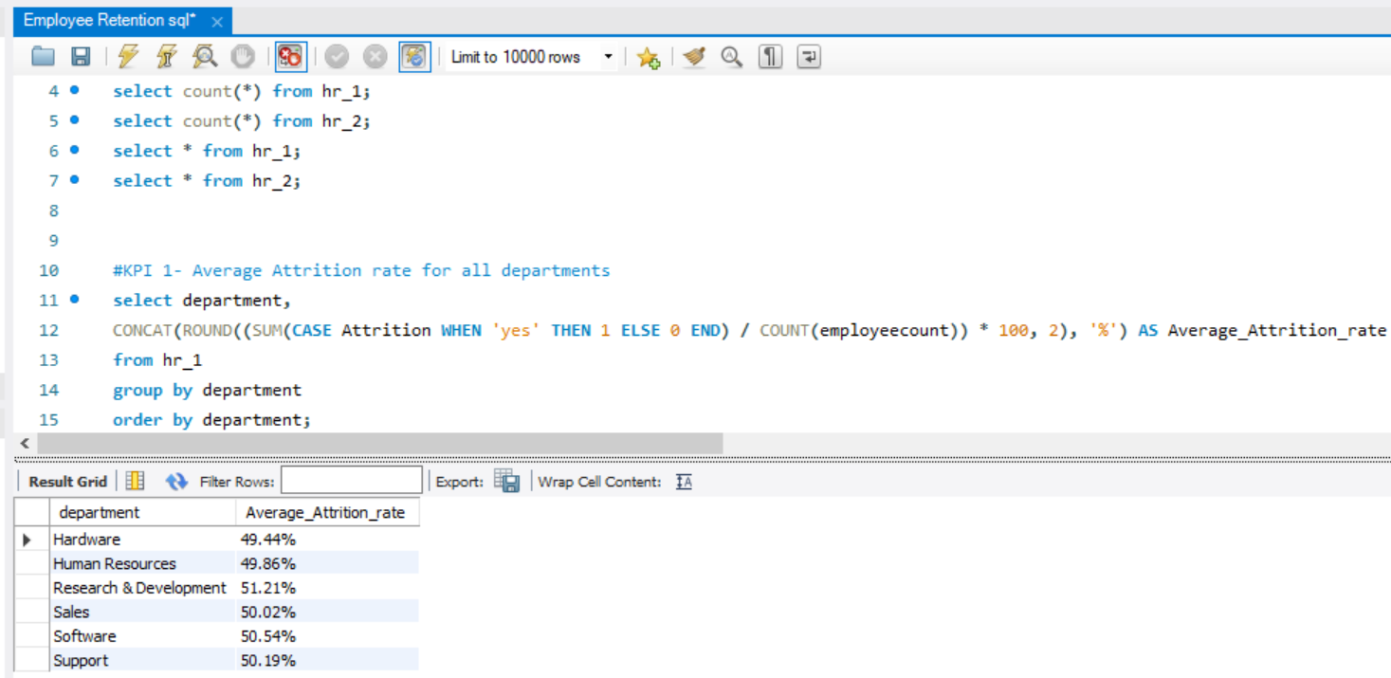
Insights from KPI-1:

Slide 8
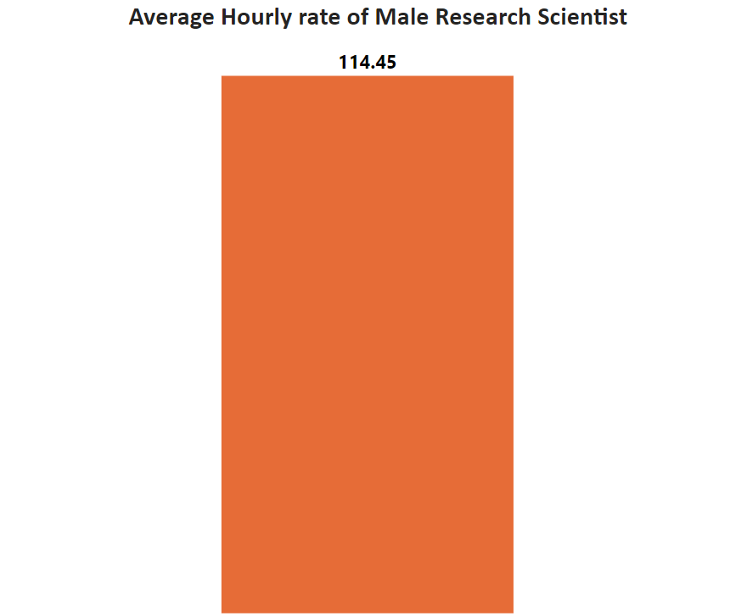
KPI-2:
Average Hourly Rate of Male Research Scientists
This KPI is to find out the average hourly rate of male research scientists which is 114.45.

Slide 9
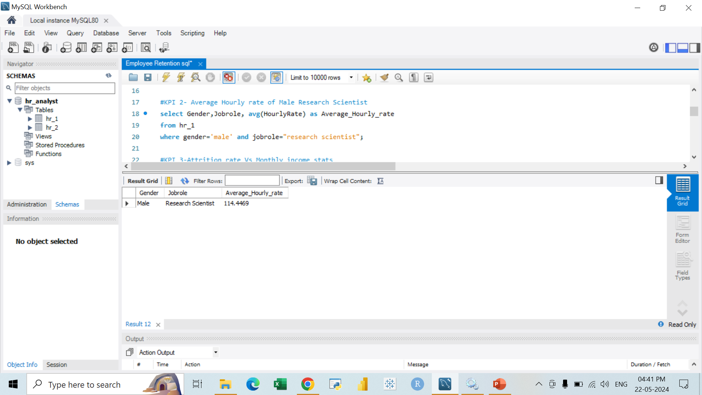
Insights from KPI-2:
This KPI is to find out the average hourly rate of male research scientists which is 114.45.
Image 1 Here
Image 2 Here

Slide 10
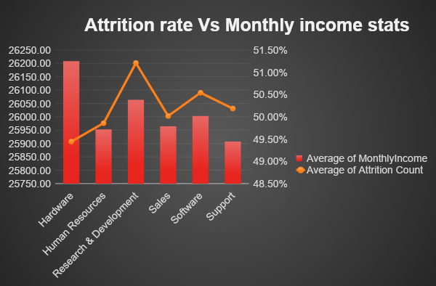
KPI-3:
Attrition Rate VS
Monthly Income Stats
This KPI is to find out the relation the between monthly income and Attrition rate.

Slide 11
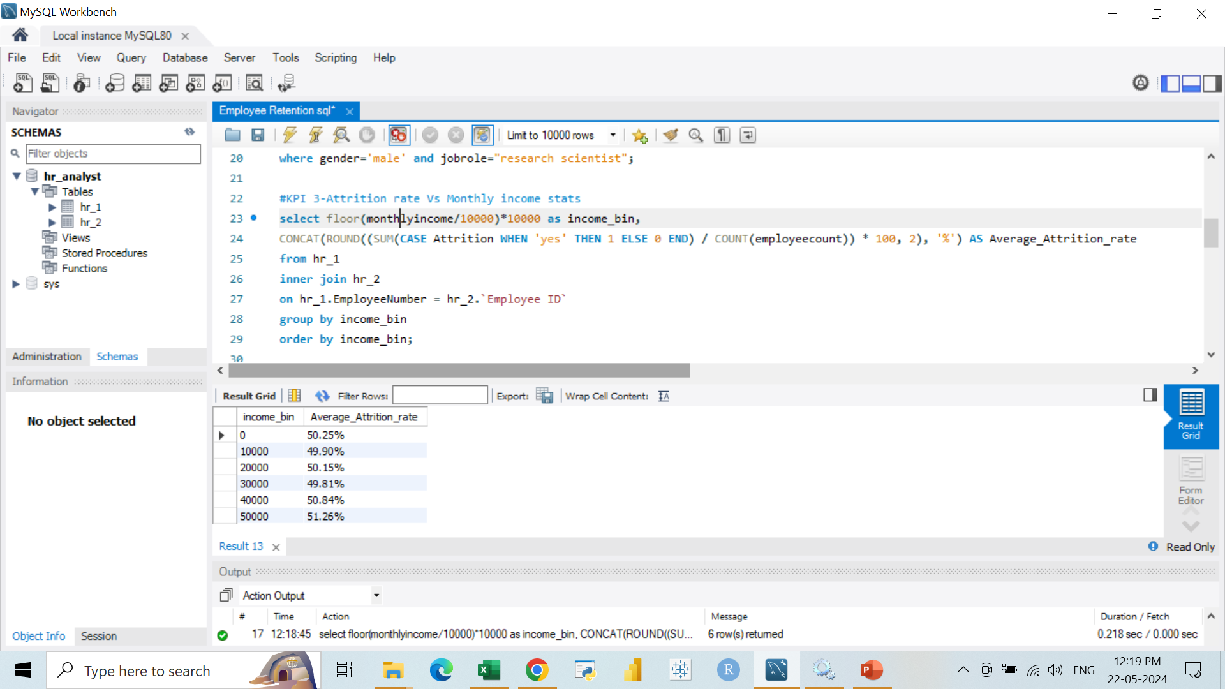
Insights from KPI-3:
Based on our analysis and visualization, it is evident that the hardware department has the lowest attrition rate of 49.81%, with an average monthly income of Rs. 30000. On the other hand, the research and development department has the highest attrition rate of 51.26%, with an average monthly income of Rs. 50000.

Slide 12
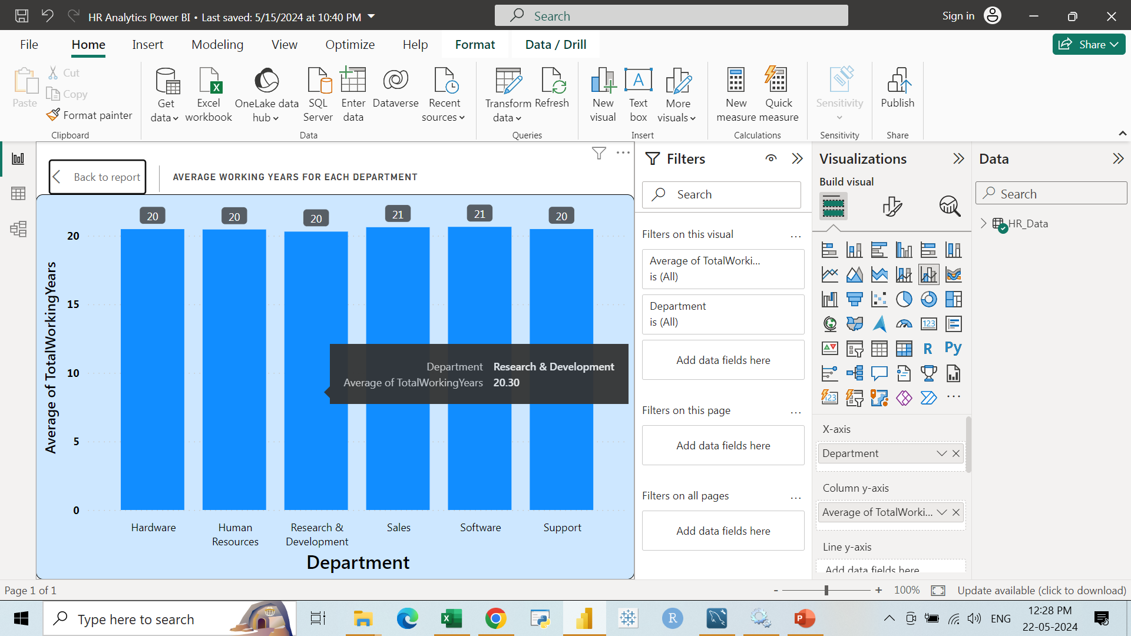
KPI-4:
AVERAGE WORKING YEARS OF EACH DEPARTMENT

Slide 13
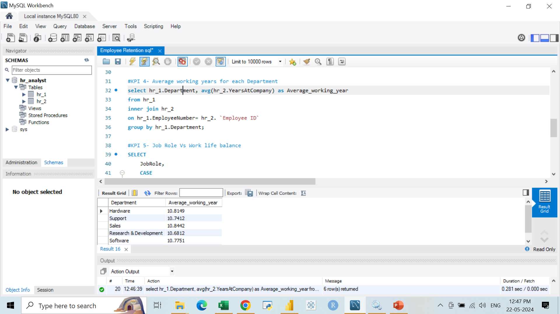
Insights from KPI-4:
Based on our analysis and visualization, it is evident that the hardware department has the lowest attrition rate of 49.81%, with an average monthly income of Rs. 30000. On the other hand, the research and development department has the highest attrition rate of 51.26%, with an average monthly income of Rs. 50000.

Slide 14
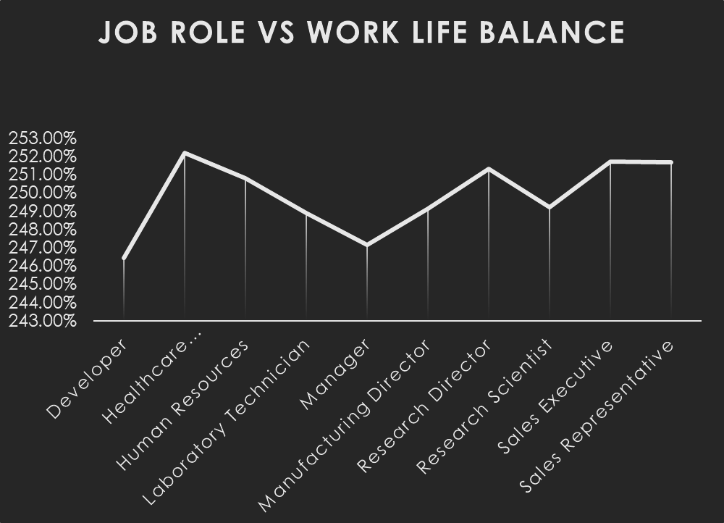
KPI-5:
JOB ROLE VS WORK LIFE BALANCE FOR TOTAL EMPLOYEES

Slide 15
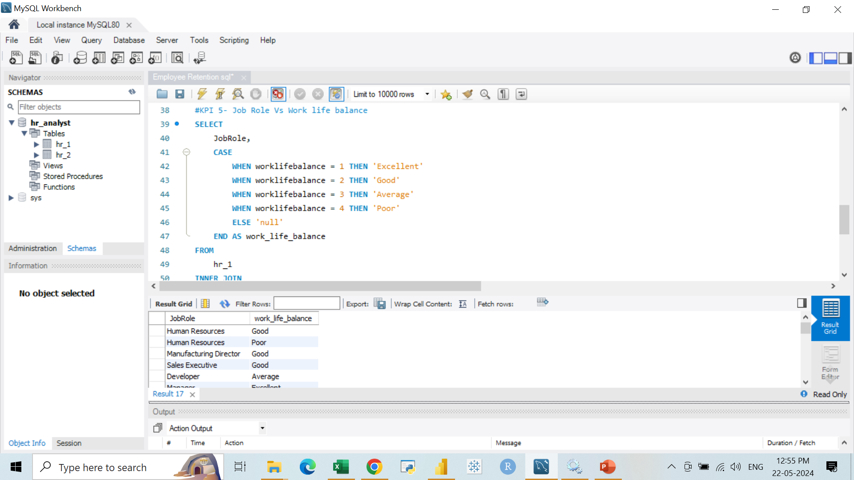
INSIGHTS FROM KPI-5
From the analysis we can conclude that, For Research directors and the laboratory technicians the work life balance is poor. For the Sales representatives , managers ,Manufacturing Directors and the Sales executives the work life balance is fair. For Research Scientists , Healthcare representatives und Developers the work life balance is good. For human resources the work life balance is excellent.

Slide 16
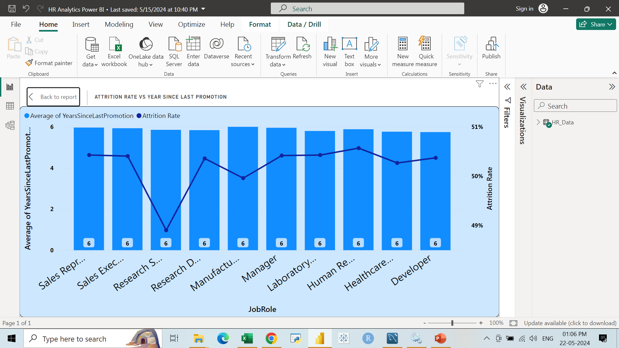
KPI-6:
ATTRITION RATE VS YEAR SINCE LAST PROMOTION

Slide 17
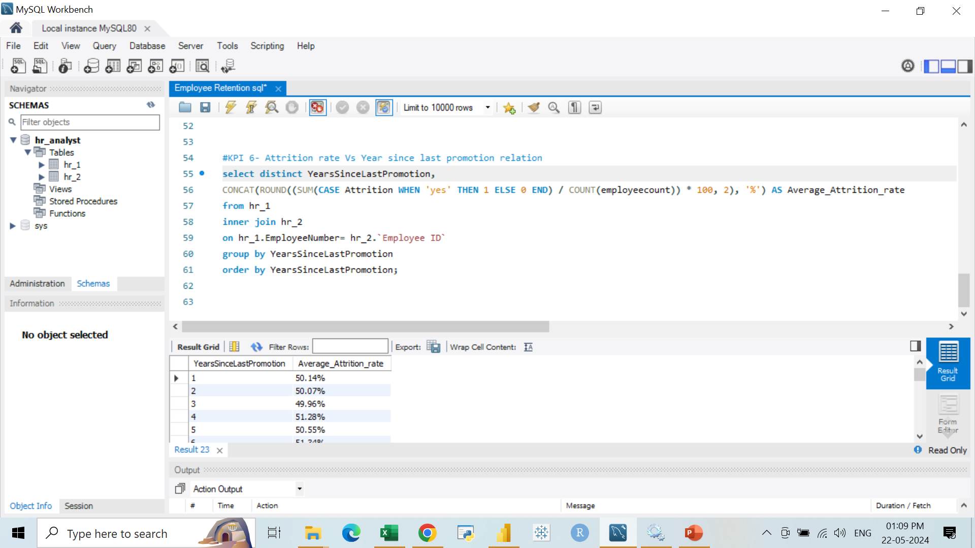

Slide 18
INSIGHTS FROM KPI-6
From the analysis and Visualisation
For 0-5 years since Last year Promotion interval Research &
Development and Hardware departments has highest and lowest
attrition rate respectively.
For 6-10 years since last year promotion interval Human resources
and software departments has highest and lowest attrition rate
respectively.
For 11-15 years since last promotion interval support and sales departments has highest and lowest attrition rate respectively.
For 16-20 years since last promotion interval software & hardware departments has highest and lowest attrition respectively.

Slide 19
INSIGHTS FROM KPI-6
For 21-25 years since last promotion interval software and support
departments has highest and lowest attrition respectively.
For 26-30 years since last promotion interval support and Human
resources departments has highest and lowest attrition respectively.
For above 30 years since last promotion interval software and Human
resources departments has highest and lowest attrition respectively.

Slide 20
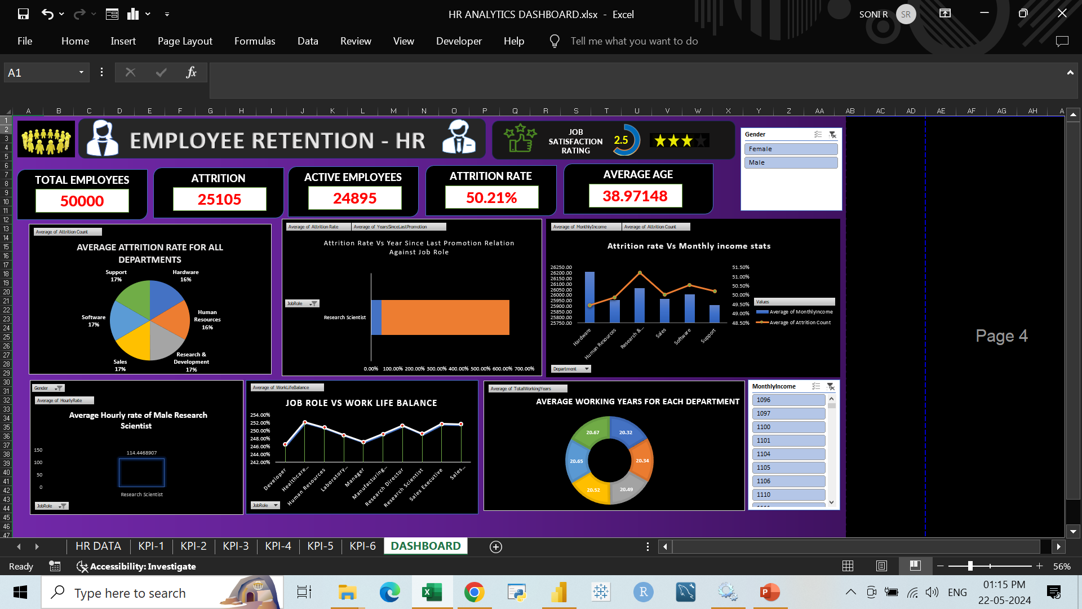

Slide 21
Conclusion
Conduct stay interviews: Instead of exit interviews, conduct stay interviews with employees to gather feedback about the job.
Improve employee engagement: Implement initiatives to improve employee engagement, such as regular feedback, recognition and rewards programs, and opportunities for career growth.
Address workload issues: Ensure employees have manageable workloads by regularly monitoring and adjusting workloads to prevent burnout and overwhelm.

Slide 22
Thank you!

